Slide 1
TBIT-MSC- West Remote Gates

Slide 2
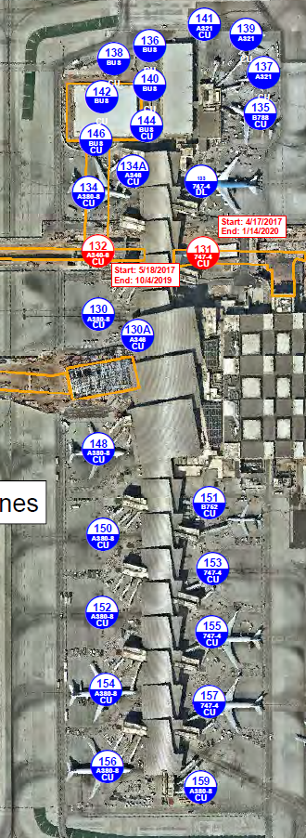
TBIT Gates
19 TBIT contact gates (17 Currently)
8 ADG VI, 15 ADG V (except G135- B787-8 and smaller),
4 ADG III

Slide 3
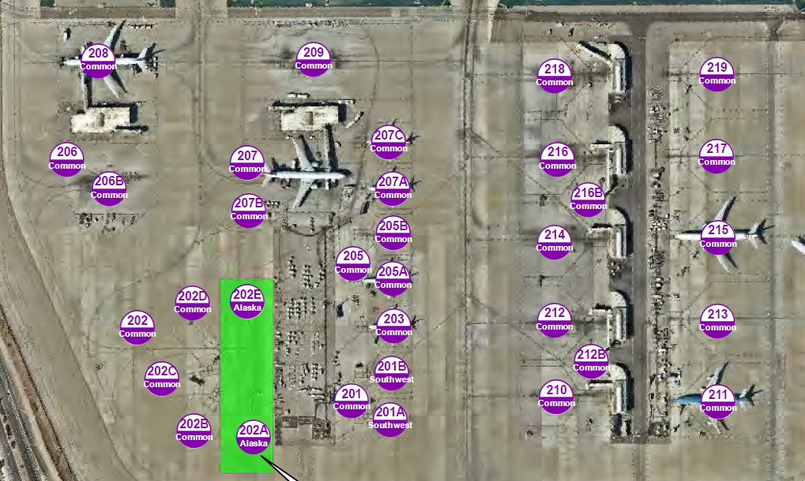
West Remote Gates
9 with PBBs
17 ADG III Hard Stand Gates (2 WN lease and 2 AS lease)
5 ADG V Hard Stand Gates
2 ADG VI Hard Stand Gates (1 part of WN)

Slide 4
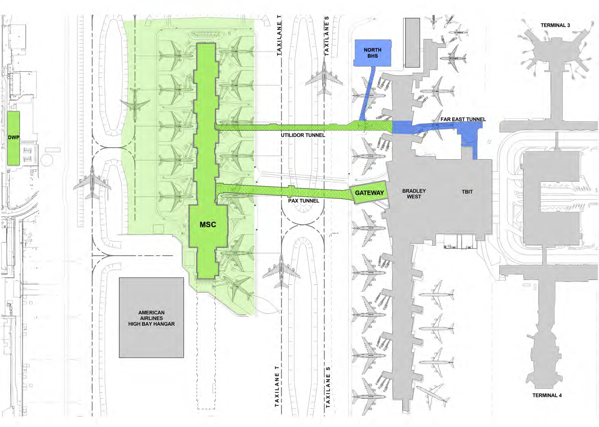
Midfield Satellite Concourse (MSC) 12 Gates- 3 w/ dual ADG III parking

Slide 5
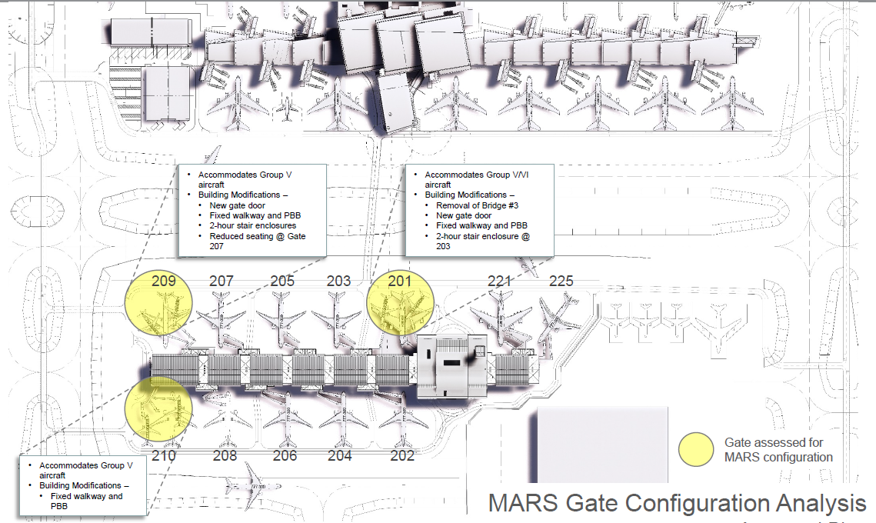
MSC w/ Gate Numbers and Accommodations

Slide 6
MSC Airline Candidates
KLM
Air France
Hawaiian
Frontier
Norwegian
Etihad
Interjet
Fiji
Phillipines
Emirates
Aer Lingus
Air Tahiti Nui
Volaris
Southwest
Honk Kong Airlines
El Al
China Southern

Slide 7
Construction Impacts
Gate 131 Closed MSC far east tunnel
Approx. 20 month closure. Open late 2019
Gate 132 Closed MSC TBIT BHS
Approx. 20 month closure. Open late 2019
Gate 134 Next for BHS after 132 opening

Slide 8
Airline Activity
55 Airlines (includes AA, DL, UA, WN and airlines gated only CM, AV, 4O)
Total average daily turns departures/arrivals is 120
Approximately 28% of all flights have over 3 hour turn time lowering gate priority
Approximately 30 to 35 daily Group III flights
Also accommodate evening Alaska ADG III flights due to T7 FIS hours

Slide 9
Airline Activity cont…
Peaks- Noon to 1700 and 2000 to 0100
1500- 25 Average Simultaneous Operations
2200 to 2300- 28 to 29 Simultaneous Operations
0001 to 0130- 17 to 18 Simultaneous Departures
Remote Operations Vary Daily- Evening shows 2 to 4 Group III hard stand operations
Arrivals- Average Per Day 12
Departures- Average Per Day 10
Full Turns- Average Per Day 10

Slide 10
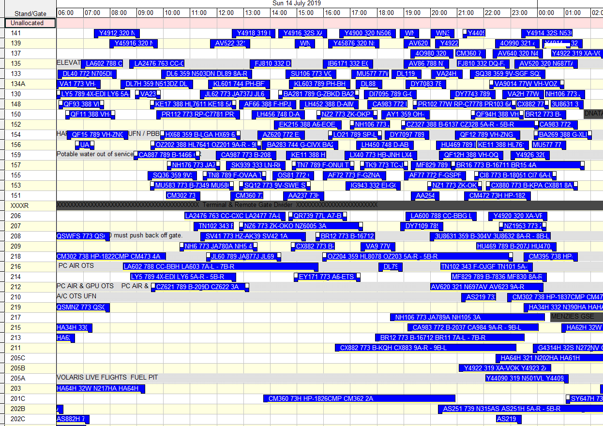
Sample of Daily Flight Activity

Slide 11
TBIT Ground Handlers
DNATA
WFS
Menzies
ATS
TAS

Slide 12
QUESTIONS?
Airport Operations Division
Photo Credit: Mike Kelley

